Slide 1
Student Database Management System
Presented By:
Dhyanendra Tripathi |Roll No: 221010218
Branch : ECE
Supervisor: Dr. Santosh Kumar
International Institute of Information Technology, Naya Raipur

Slide 2
PRESENTATION CONTAINS
Abstract
Introduction
Methodology
Features
Project Preview
Conclusion
References

Slide 3
ABSTRACT
The Student Database Management System is an original Object-Oriented Programming (OOPs) project developed using Python and custom Tkinter. It is designed to efficiently manage student data and provide administrators with convenient tools to perform various tasks and analyze the data. The system offers both admin and normal user access, ensuring secure and personalized interactions. The Student Database Management System leverages the power of Python, OOPs principles, and custom Tkinter to create a robust and efficient solution for managing student data. With its user-friendly interface and comprehensive features, the system streamlines administrative tasks, enhances data organization, and improves overall efficiency in a student-focused environment.

Slide 4
INTRODUCTION
TERM | DEFINITION
Student Database Management System | Student Database Management System is a software application developed using Python and custom Tkinter that provides a comprehensive solution for managing student data. It follows the principles of Object-Oriented Programming (OOPs) to ensure modularity, scalability, and code reusability.
Object Oriented Programming | By leveraging OOP principles, the Student Database Management System achieves modular design, code reusability, and flexibility. It allows for easier maintenance, scalability, and extensibility of the application. OOP enables a structured and organized approach to software development, enhancing the overall quality and maintainability of the project.

Slide 5
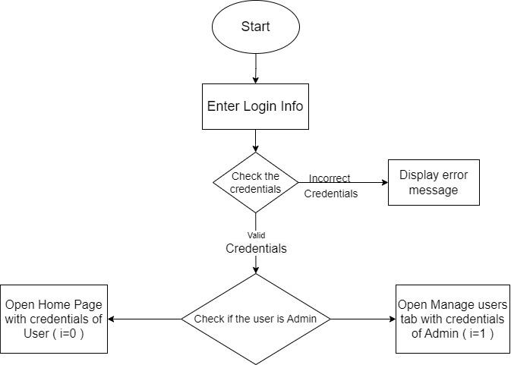
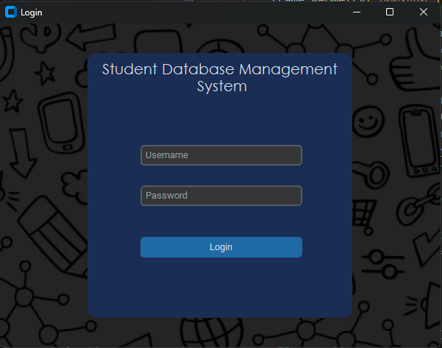
Methodology (Login)

Slide 6
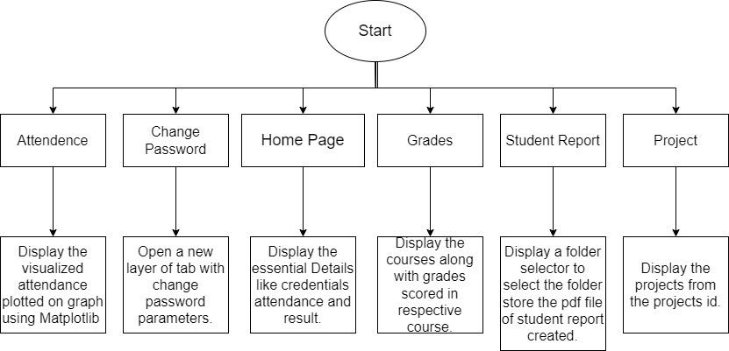
Methodology(All Users)

Slide 7
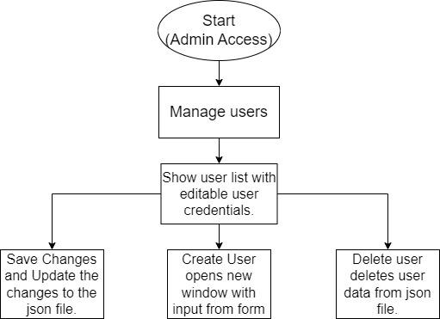
Methodology(Admin user)

Slide 8
Features
Course wise attendance visualisation. (using matplotlib)
Course wise grades.
Admin access to add or remove users(students).
User Data stored in JSON file.
Student report PDF.
User friendly GUI interface designed using CustomTkinter.
Projects tab for reference for the students.

Slide 9
Project Visuals
Login Page
Security of user data.

Slide 10
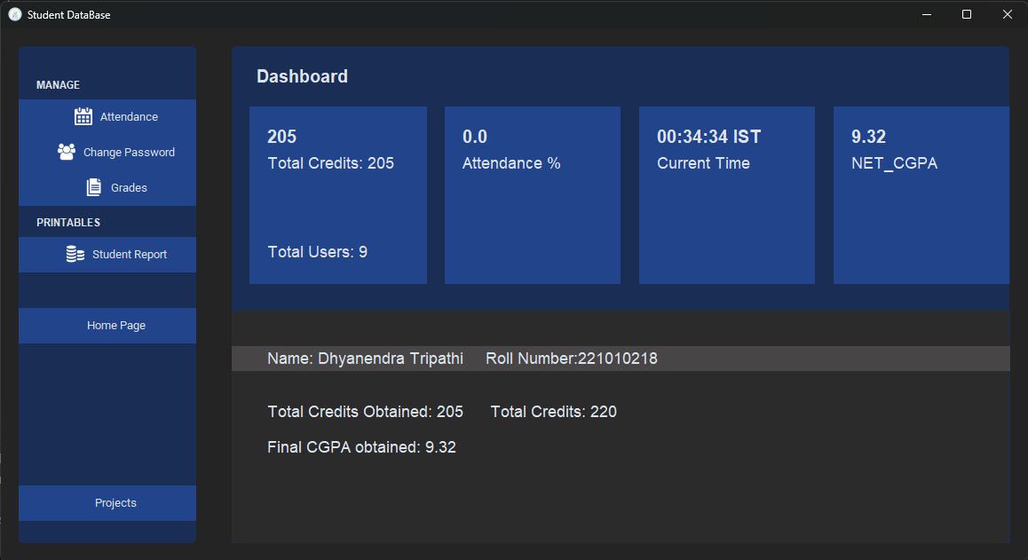
Project Visuals
Home Page
Comprehensive view of relevant user data.
Easy navigation to other tabs.

Slide 11
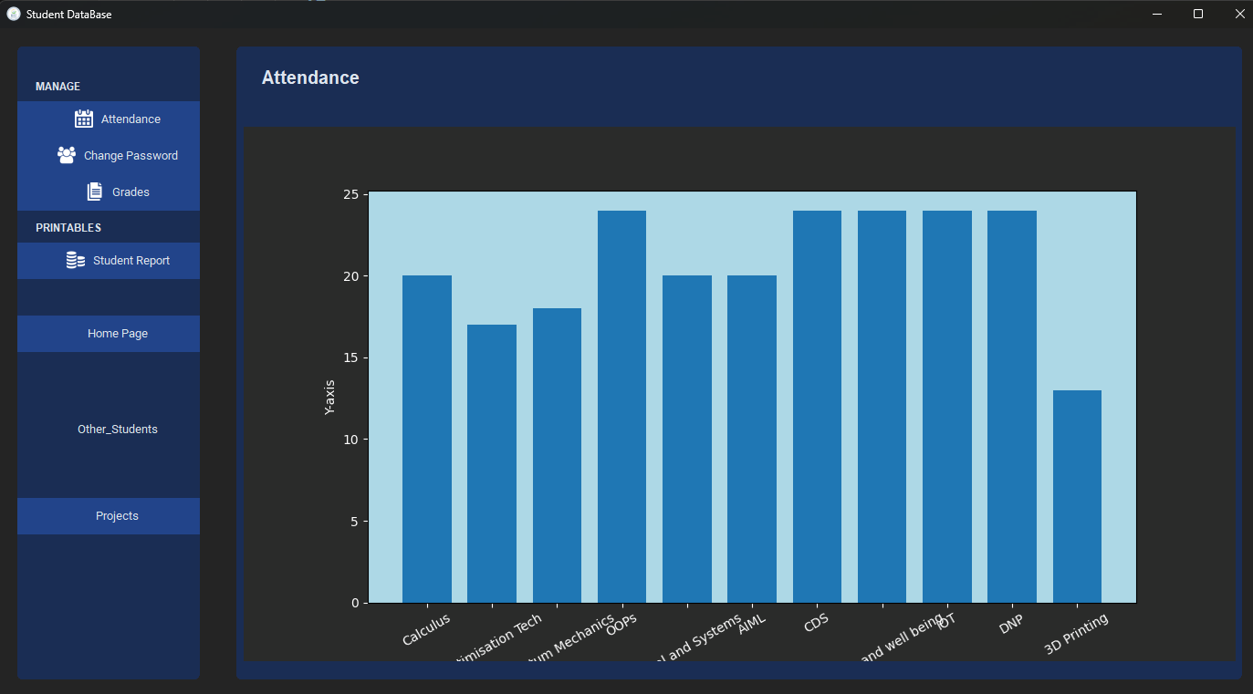
Project Visuals
Attendance Tab
Visualization of user’s attendance using bar graph.

Slide 12
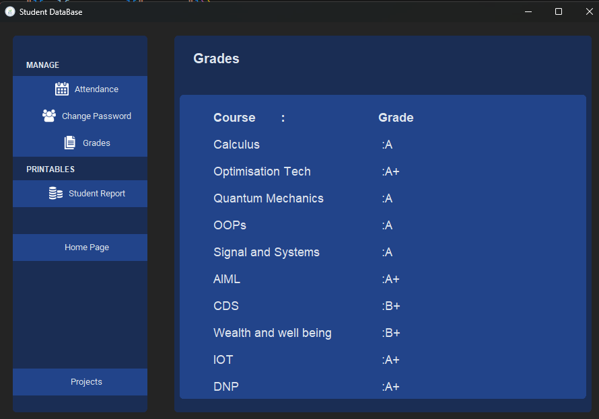
Project Visuals
Grades Tab
Subject wise grade list.
Easy navigation to other tabs.

Slide 13
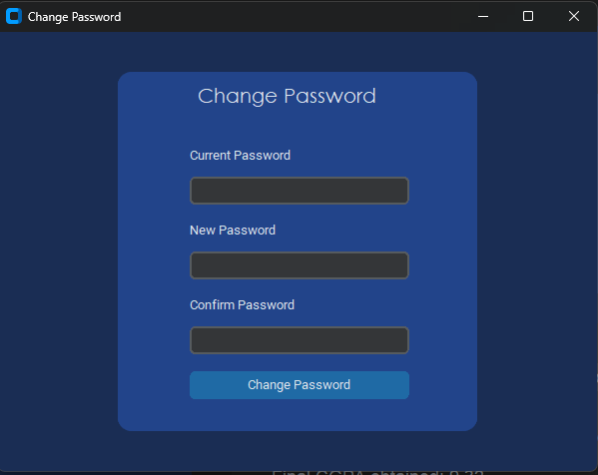
Project Visuals
Change password Tab
Easy change of password available for users.

Slide 14
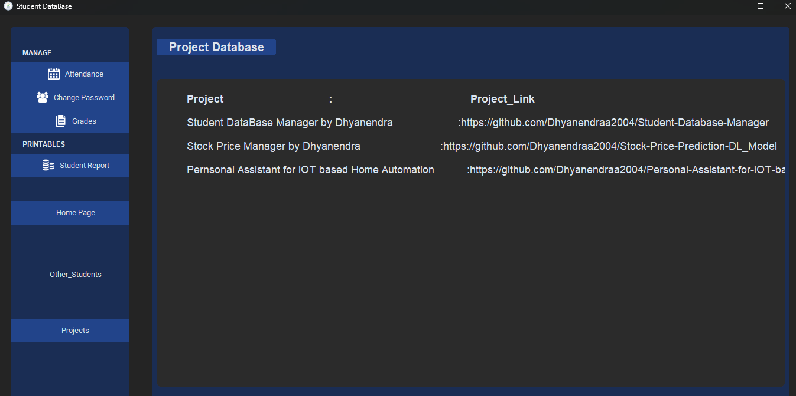
Project Visuals
Projects Tab
Project list available for every user.

Slide 15
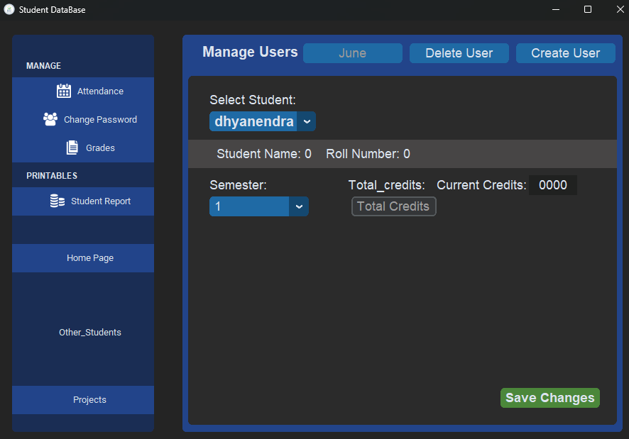
Project Visuals
Manage Students Tab
Manage users from Admin account.

Slide 16
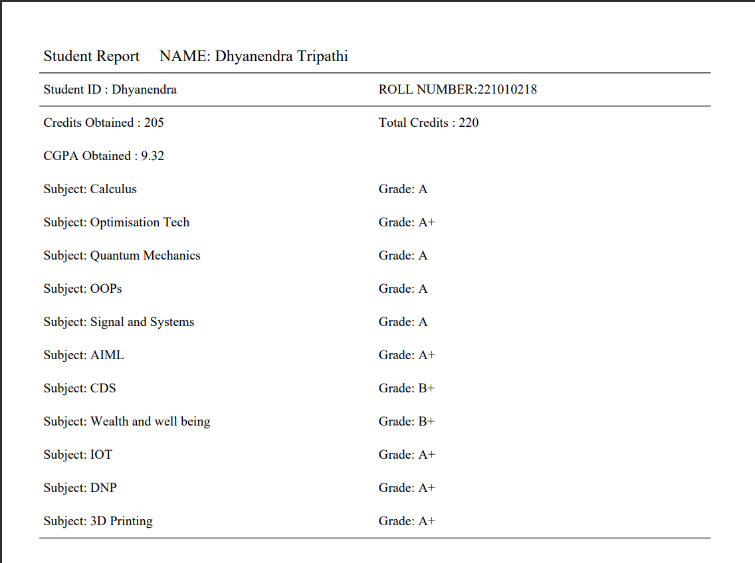
Project Preview
Student Report Tab
Downloadable PDF file of student report.

Slide 17
Conclusion
The Student Database Management System provides a comprehensive solution for managing student data in educational institutions. Its custom Tkinter-based GUI enhances usability, and the various modules cater to different aspects of student information management. With features such as attendance visualization, grade tracking, password management, project storage, and PDF report generation, the system offers an efficient and user-friendly interface for administrators, faculty, and staff involved in student data management.

Slide 18
References
https://github.com/TomSchimansky/CustomTkinter
https://pyfpdf.github.io/fpdf2/Tables.html
https://github.com/STHEBEST/Login-System

Slide 19
Thank You!

